Slide 1


FACIAL
ATTENDANCE SYSTEM
PRESENTED BY
ABHISAR TRIVEDI
21IT3002
DR. SUSHAM BISWAS
PROJECT MENTOR

Slide 2

CONTENT
01
WHAT IS FACIAL ATTENDANCE SYSTEM ?
THE SOLUTION
DATA COLLECTION
METHODOLOGY
RESULTS
LIMITATIONS
FUTURE DIRECTIONS
02
03
04
05
06
07

Slide 3
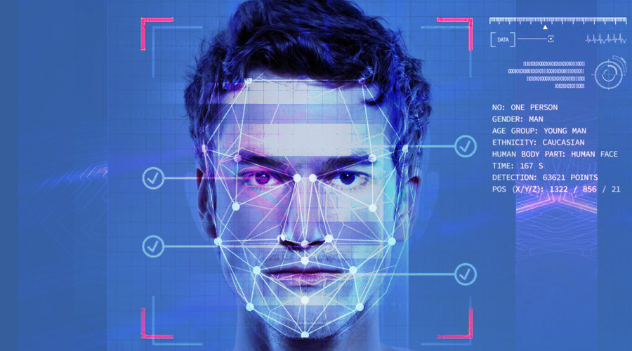


WHAT IS A FACIAL ATTENDANCE SYSTEM ?
A Facial Attendance System is a modern application of facial recognition technology that automates the attendance tracking process. It utilizes computer vision algorithms to identify individuals based on their facial features.
By capturing and analyzing facial data, such systems provide a seamless and secure way to monitor attendance in various settings, including educational institutions, workplaces, and events.

Slide 4



THE SOLUTION
Our Facial Attendance System project aimed to create an innovative solution for automating attendance tracking using facial recognition technology.
The system leverages machine learning algorithms to recognize and authenticate individuals based on their unique facial features.
By integrating this solution into existing attendance management systems, we aimed to streamline the attendance recording process, reduce errors, and enhance overall efficiency.

Slide 5





DATA COLLECTION
The data collection phase involved gathering a diverse dataset of facial images representing individuals from different demographics and backgrounds. This dataset ensured robustness and accuracy in recognizing faces across various conditions such as lighting, facial expressions, and angles. Only one photo of a person was stored as the dataset and the rest recognition part was handled by face_recognition module. The information and the image for the person was then stored and updated in the Firebase.

Slide 6
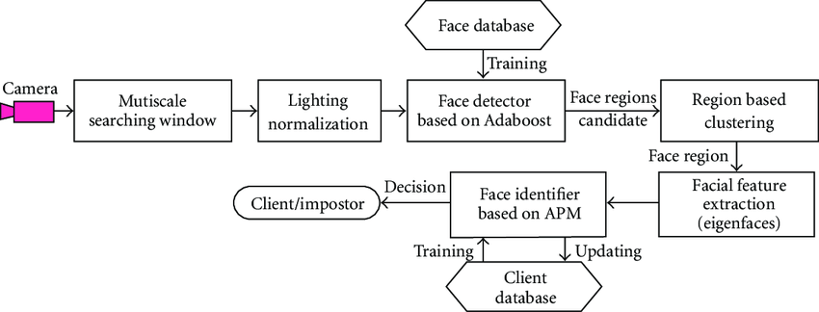

METHODOLOGY
Here is the stepwise illustration of the data collection methods I took
Data collection was manually done by me only filling the photo and feeding with the information about the student
Each collected photo was accompanied by its info in a dictionary format having keys and values and uploaded and updated in the Firebase.
It will be refreshed after a student comes back after the reset time for the attendance (can be anything according to the institute).
The data was then updated in the UI of my attendance system when it detected the face of a registered student.
Then after marking the attendance it will say already marked and then show active being standing by.
STEP 1
STEP 3
STEP 2

Slide 7

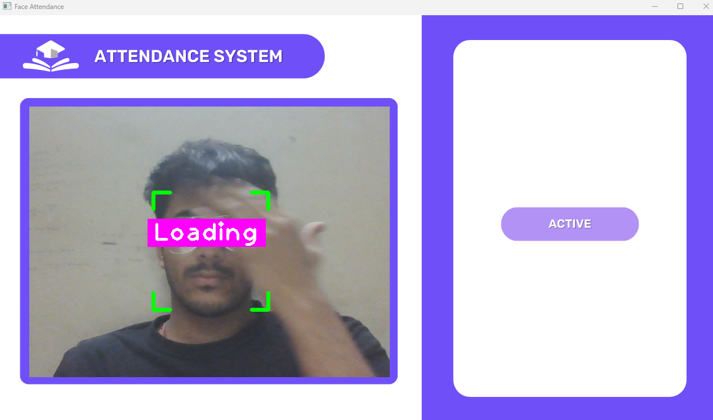
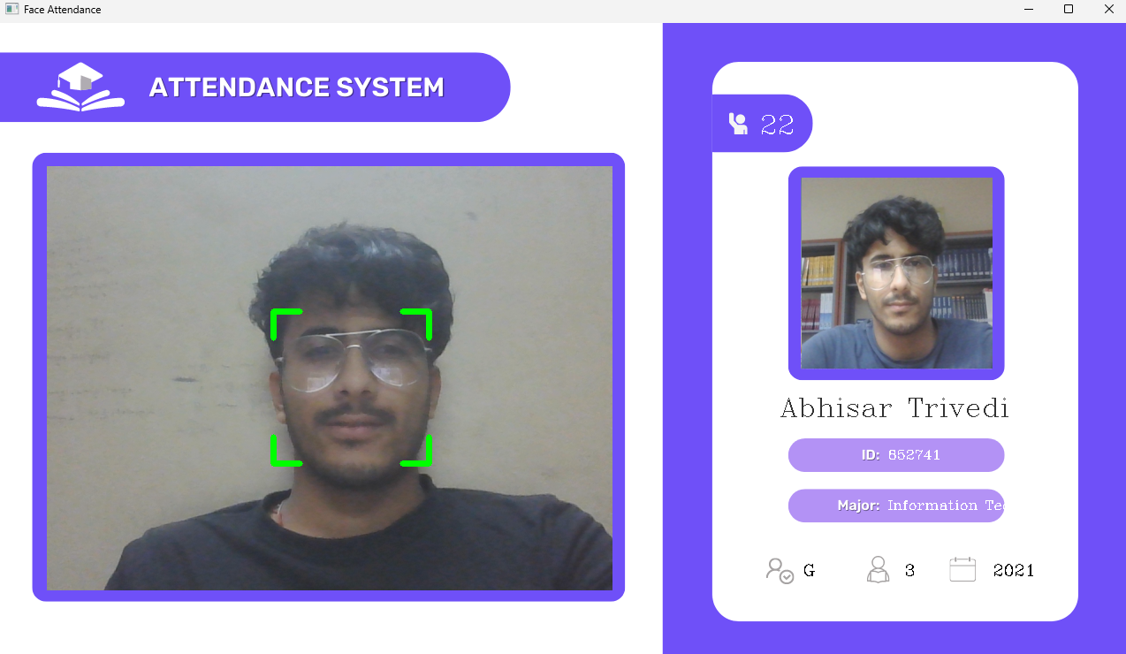
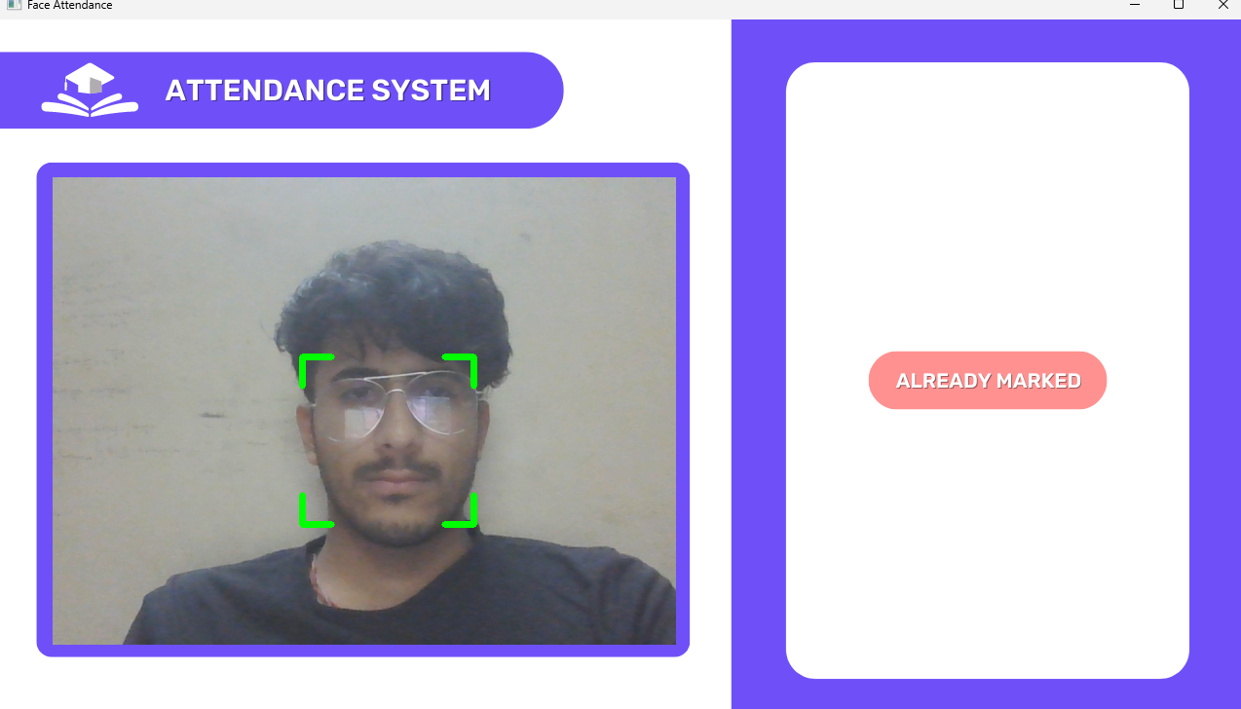
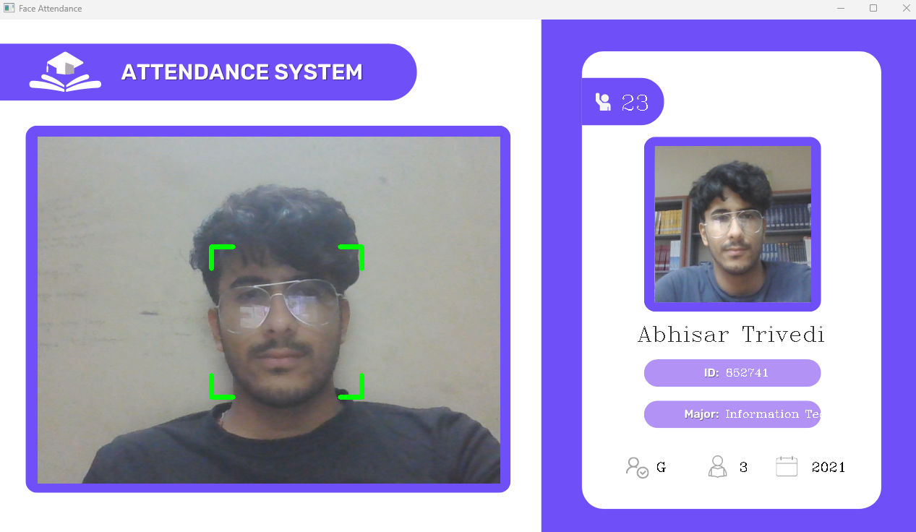
RESULTS
Updated Attendance
Here you can see the outcomes, of various timeframes of my Facial
Attendance System.

Slide 8



LIMITATIONS
Less powerful CPU and Internet eventually lead to lower efficiency as the time it will take to run and update the details will be affected.
Taking Good Quality Images also in short amount of time is another essential part of the whole Attendance System which is not that easy thing to do.
Inappropriate lighting conditions and not carefully letting the detection take time can vary results.
LESS RESOURCES
LIGHTING CONDITIONS
CAMERA QUALITY

Slide 9


FUTURE DIRECTIONS
05
06
07
08
MAY
JUNE
JULY
AUGUST
Looking forward to infuse this project with my earlier Facial Anti-Spoofing Project which will then revolutionize the attendance system as it will not only mark the student with just a facial scan but also he/she cannot mark other person’s attendance using their photo also as my anti-spoofing project will take care of it .

Slide 10

THANK YOU

